Slide 1
Putting Rigid Objects to Rest
Hossein Baktash
Mentors: Qingnan(James) Zhou, Alec Jacobson

Slide 2

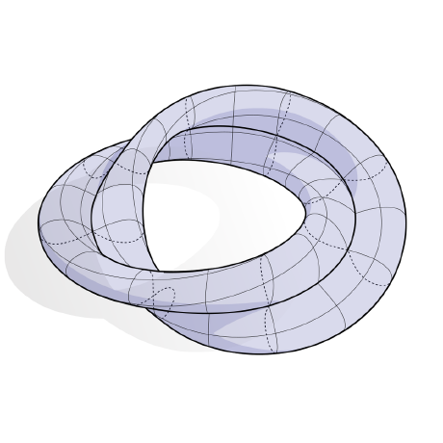
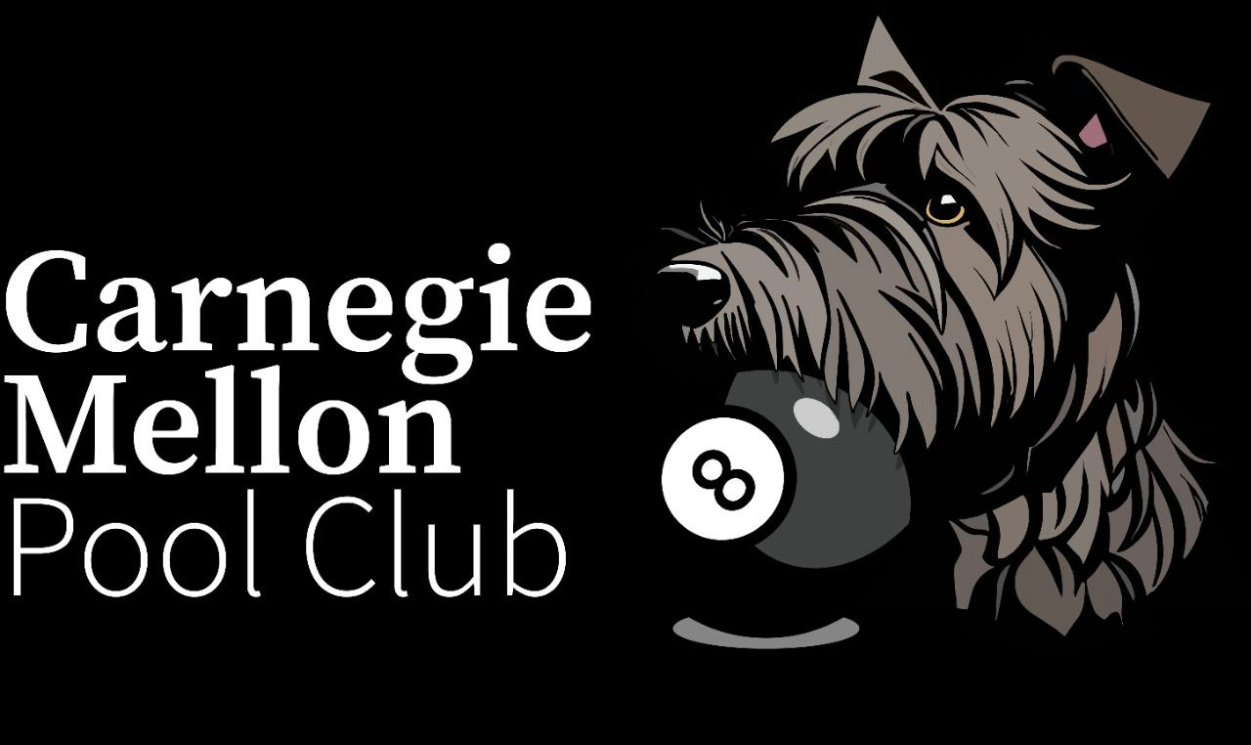
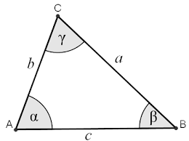
About Me
Hi I’m Hossein Baktash!
Returning intern!
3rd year PhD student at CMU
Member of the Geometry Collective team
Interested in any problem that has geometry!
Geometry processing
Graphics
Differential Geometry
…
Hobbies
Pool (billiards)
Hiking
Drawing

Slide 3

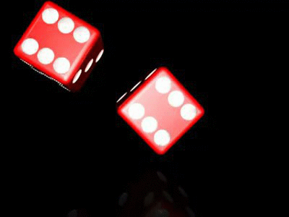
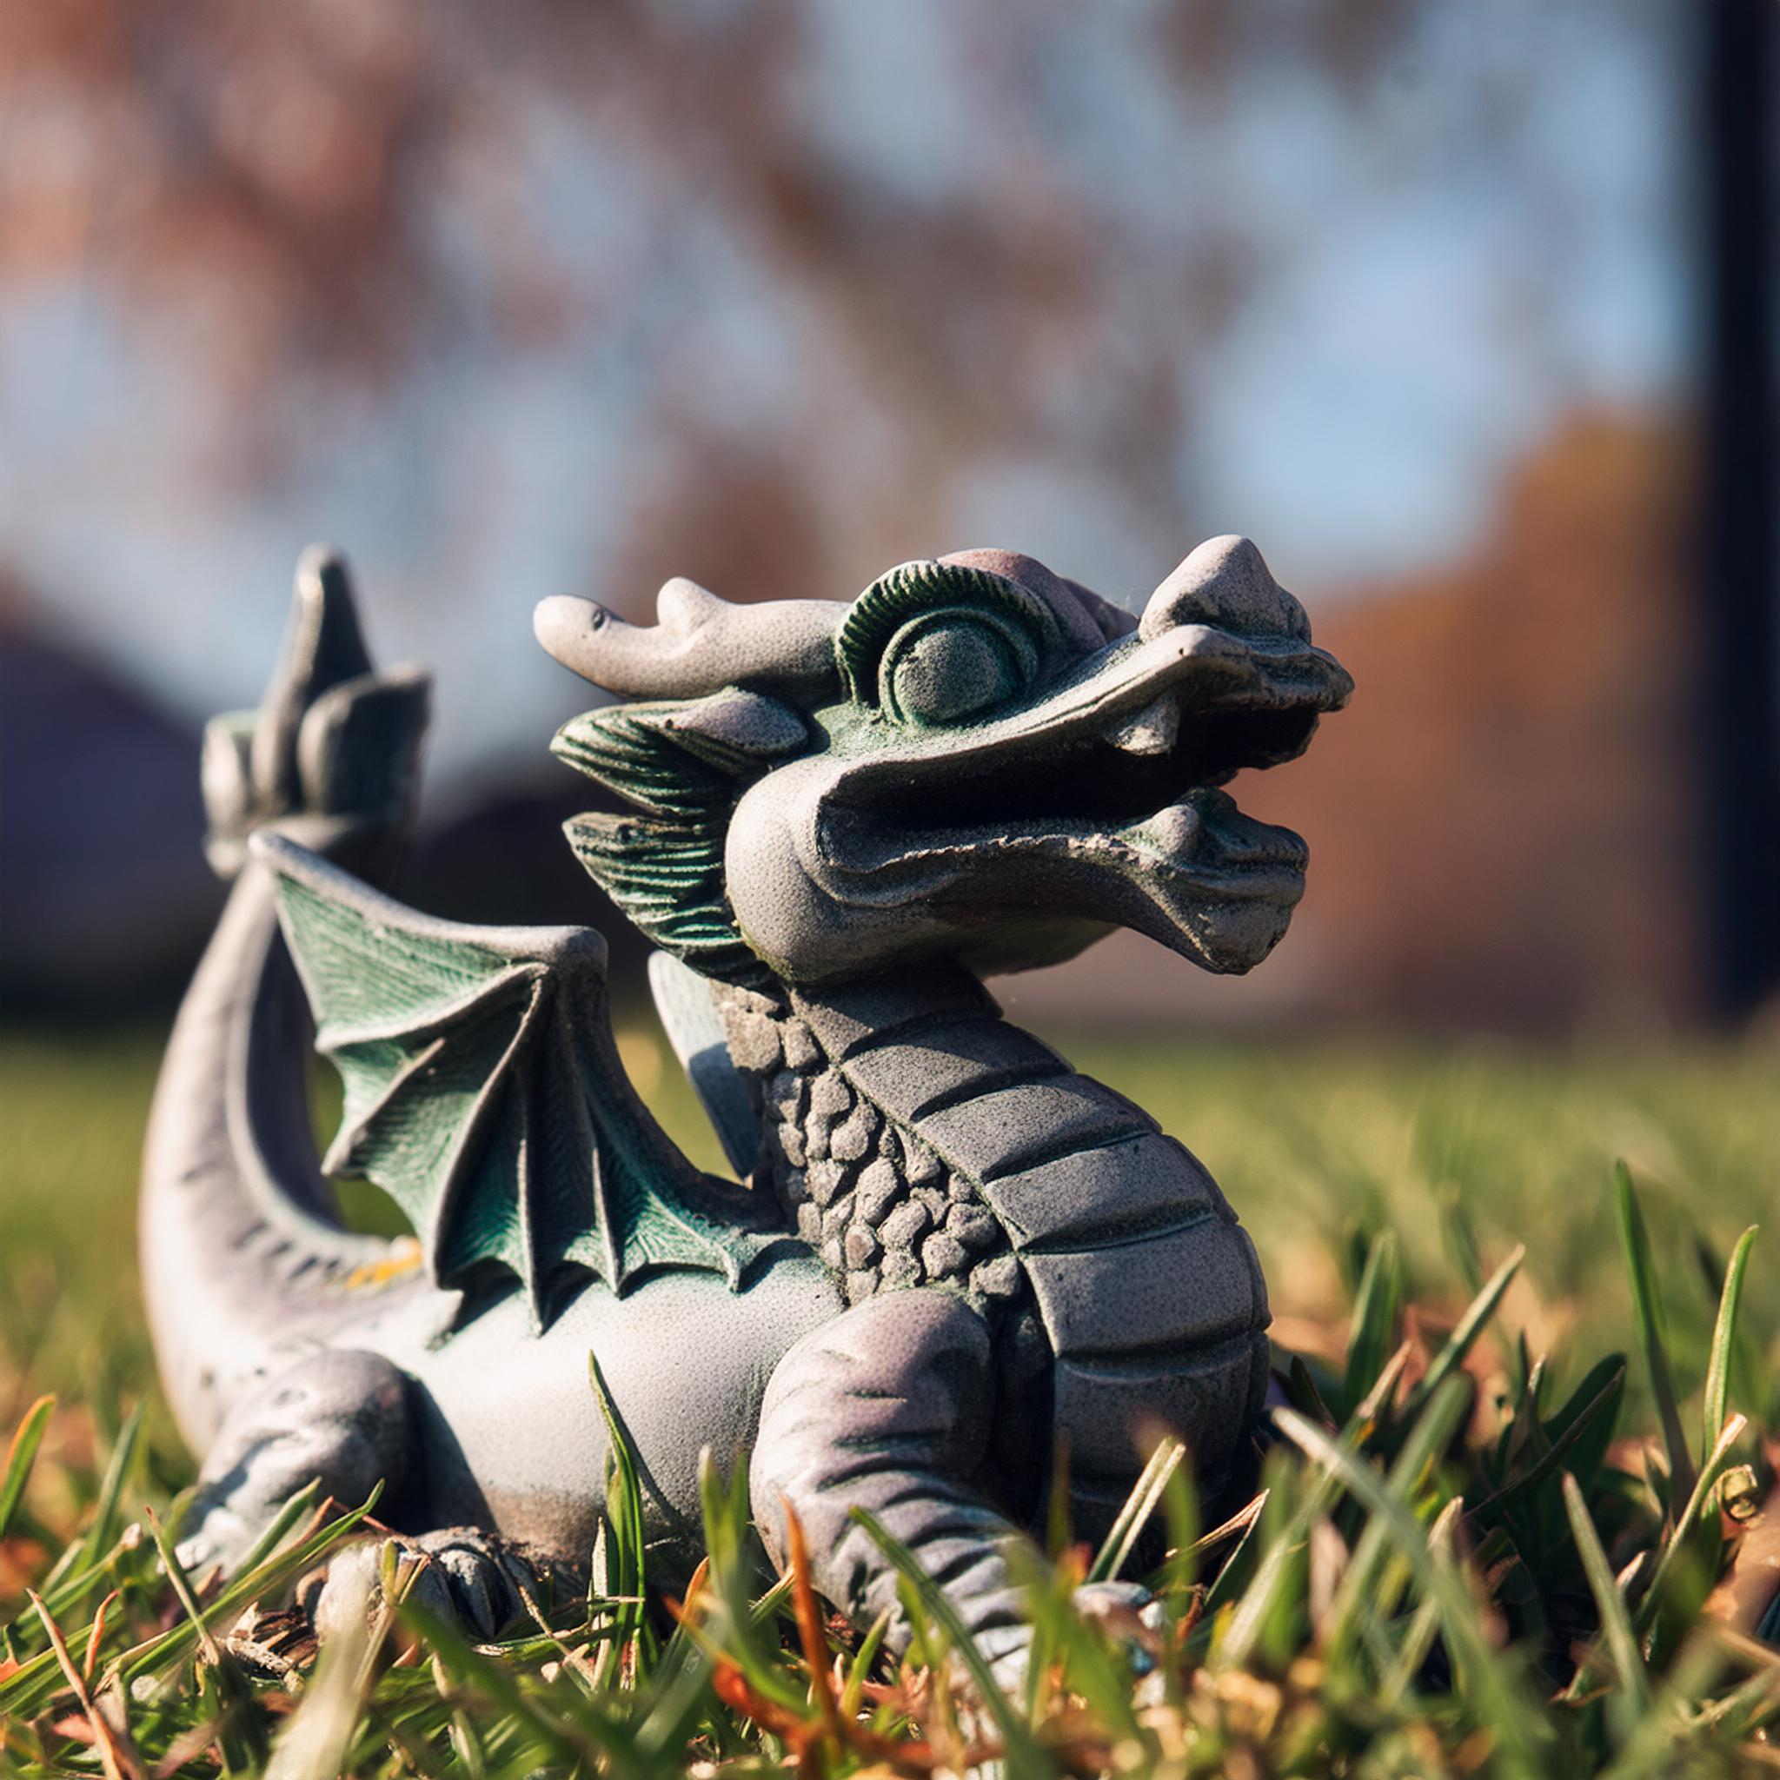
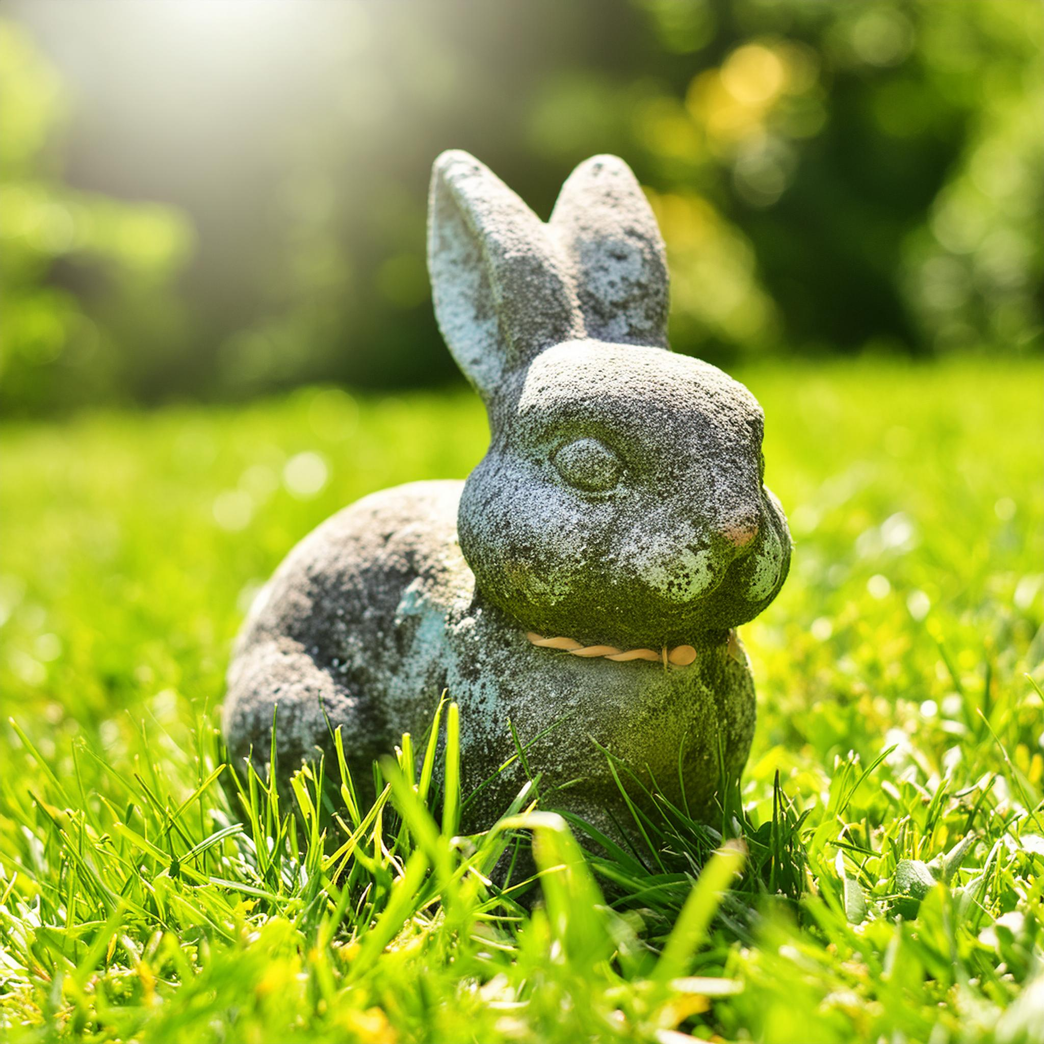
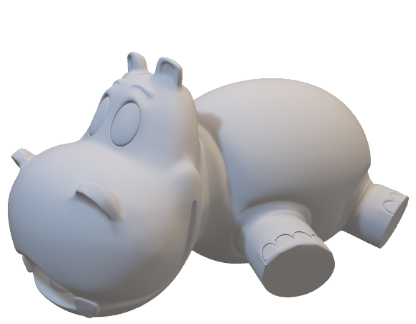
How do rigid objects rest on the ground?
Notes:
Designer designs an object, object gets manufactured and starts existing in the real world, how does it rest on the ground?

Slide 4
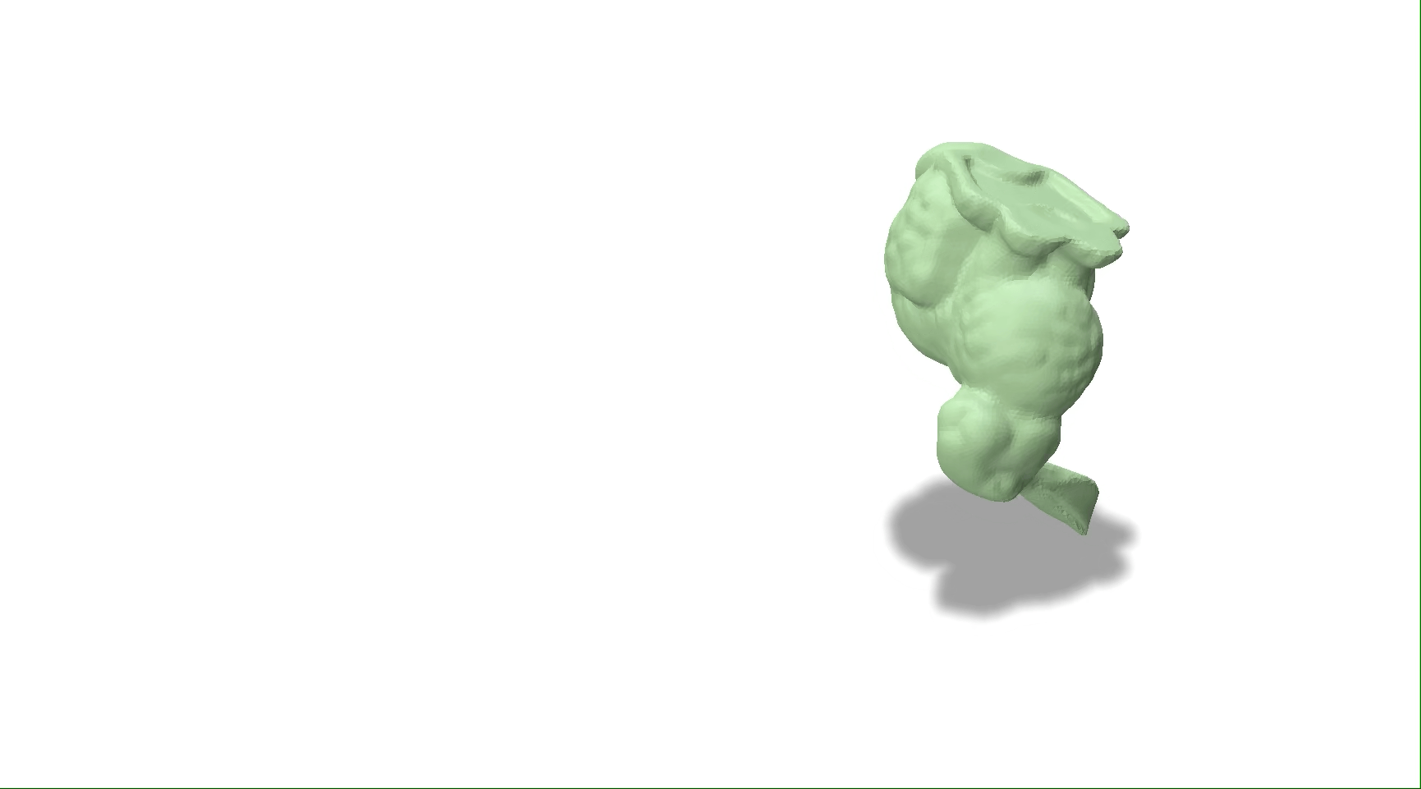
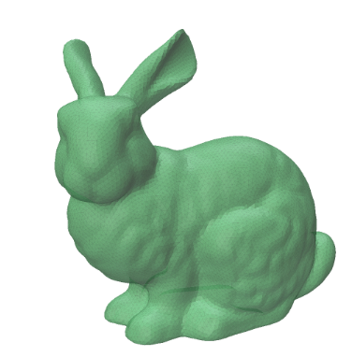
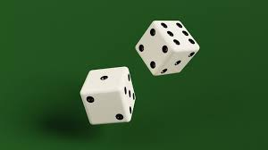
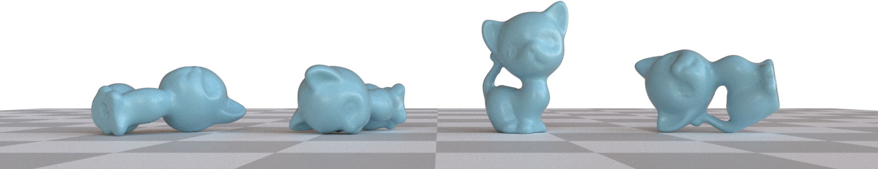
Determining rest orientation of an object
Immediate solution:
Use a rigid body simulator e.g., Bullet Physics
A natural question: What is the probability of resting on a stable configuration?
Use a simulator? and sample all possible initial orientations
Too slow!
Which is least/most probable?
Notes:
Can always do physical simulation. What if we don’t know how the object is being dropped or don’t know the physical environment. Intuitively and geometrically can talk about probabilities! Make the intuition exact!

Slide 5
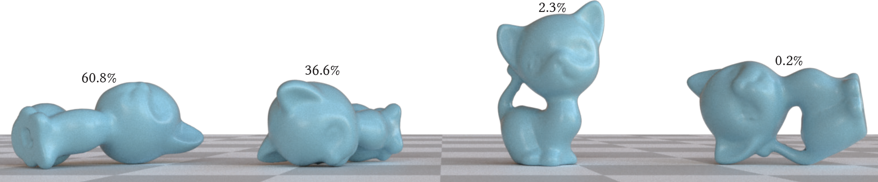
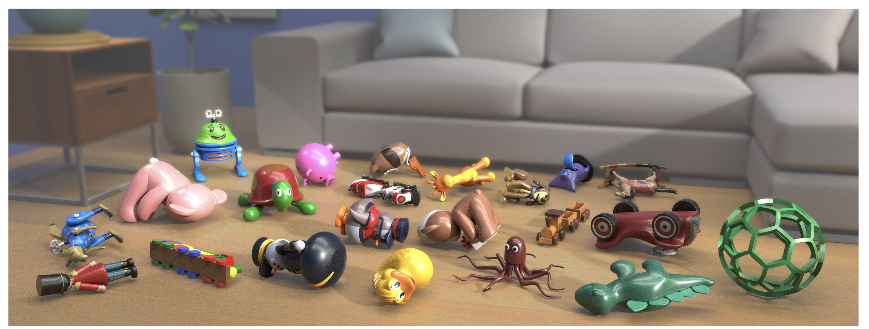
Determining probabilities of stable orientations
A purely geometric way of finding the probabilities
Given a shape and its center of mass
SIGGRAPH Asia submission! Teaser: Each toy placed on the ground with the most probable orientation

Slide 6
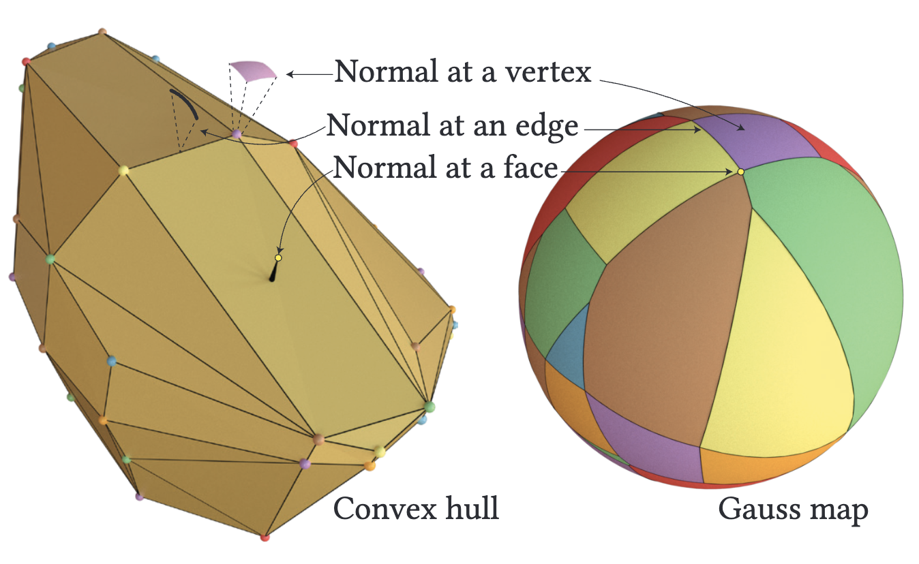
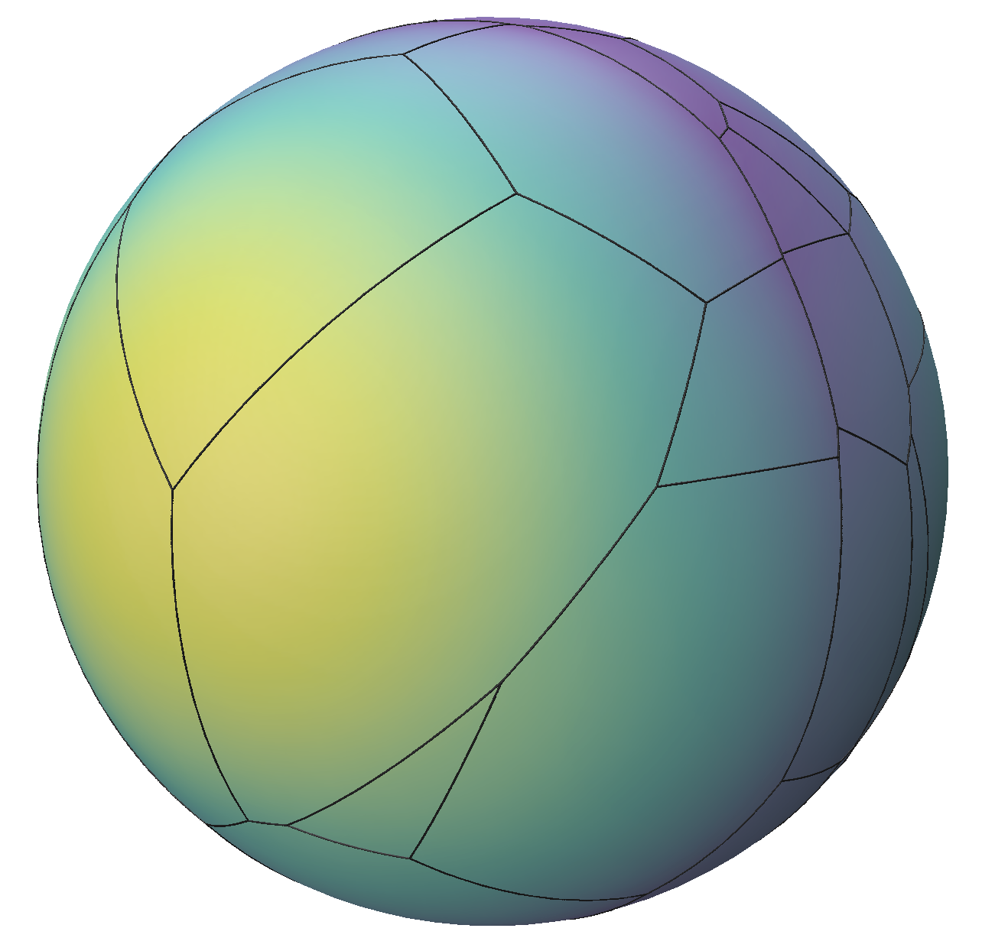
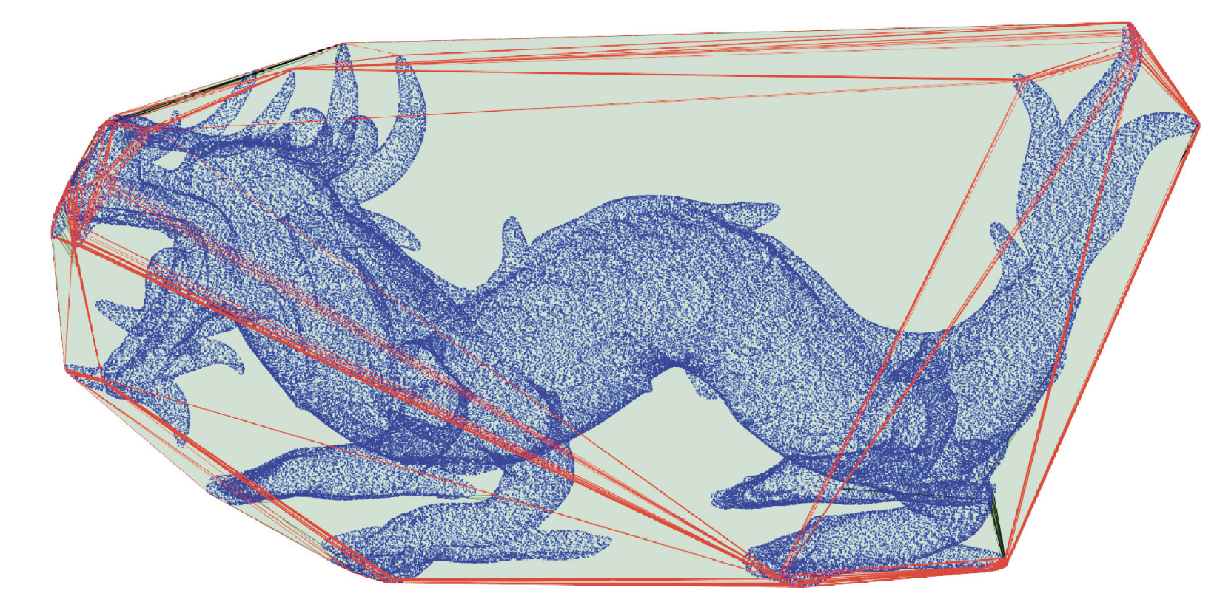
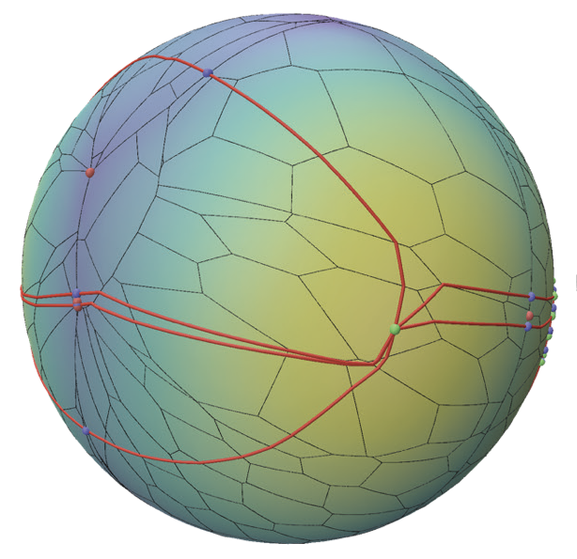
Our approach
Gauss map of the convex hull
A gravitational potential function on the Gauss map
Find the convex hull of the shape
Probabilities = Area of red regions
All done faster than a single instance of a simulation!
Notes:
Brief pipeline overveiw

Slide 7
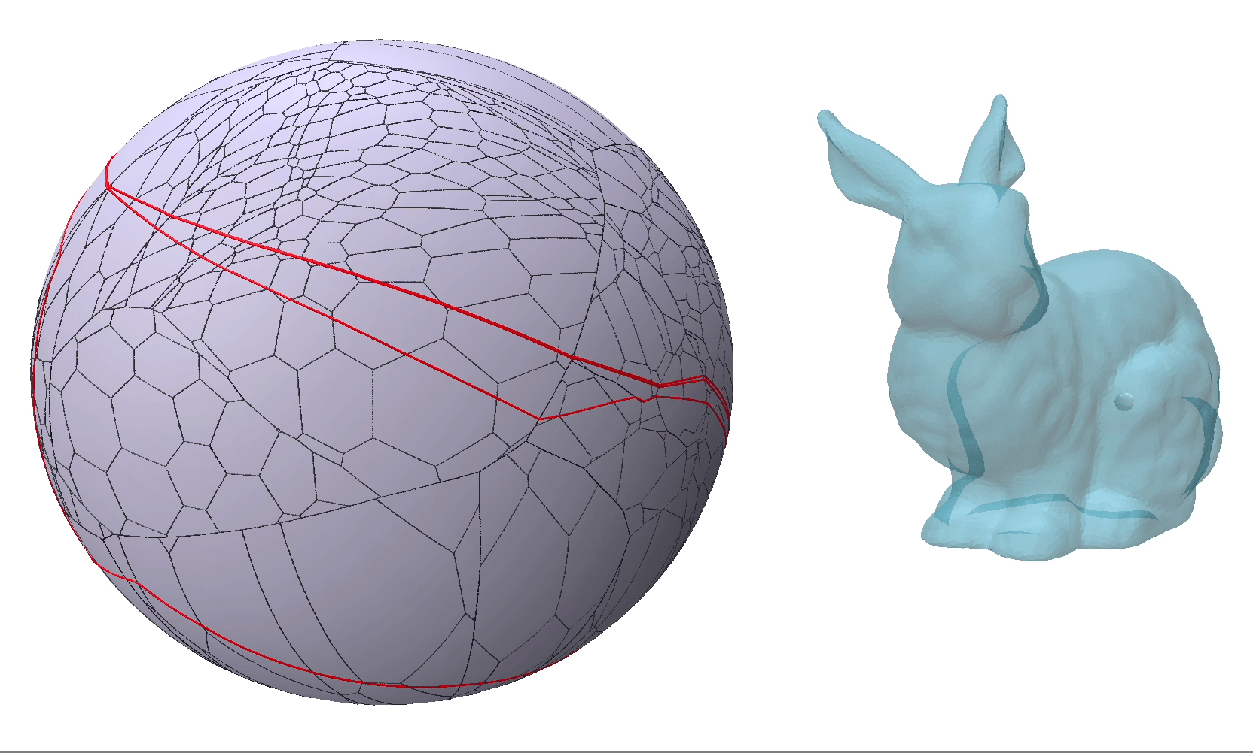
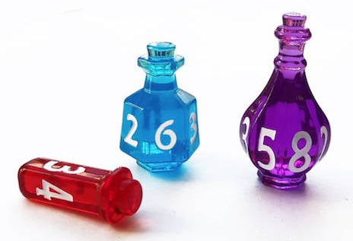
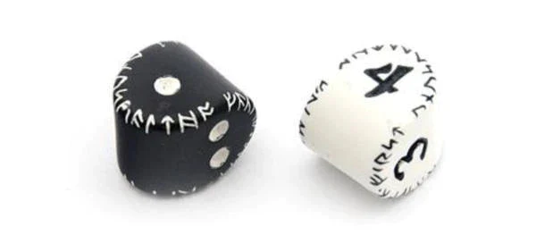
Application
Design aid
A user modifies the shape, or its center of mass
The probabilities can be computed in real-time
Make a certain orientation more stable or less stable
Achieve a certain probability distribution
E.g., turning your favorite object into a fair dice!
Doing all of this with a search in the design space is not always feasible!

Slide 8
Project Goals
Suggest changes or do them automatically
Differentiate the probabilities
Automatically modify the shape to achieve a desired distribution
Fit the original (non-convex) shape into the new convex hull
Inverse mode (differentiate the probabilities)
Modify the convex hull and center of mass
Forward mode (finding probabilities)
(done!)
(in progress … )

Slide 9
How the future steps might look like
Modifying the convex hull
Modifying the interior shape
Video goes here
Video goes here

Slide 10
Thank you for your time!
@haktash

Slide 11
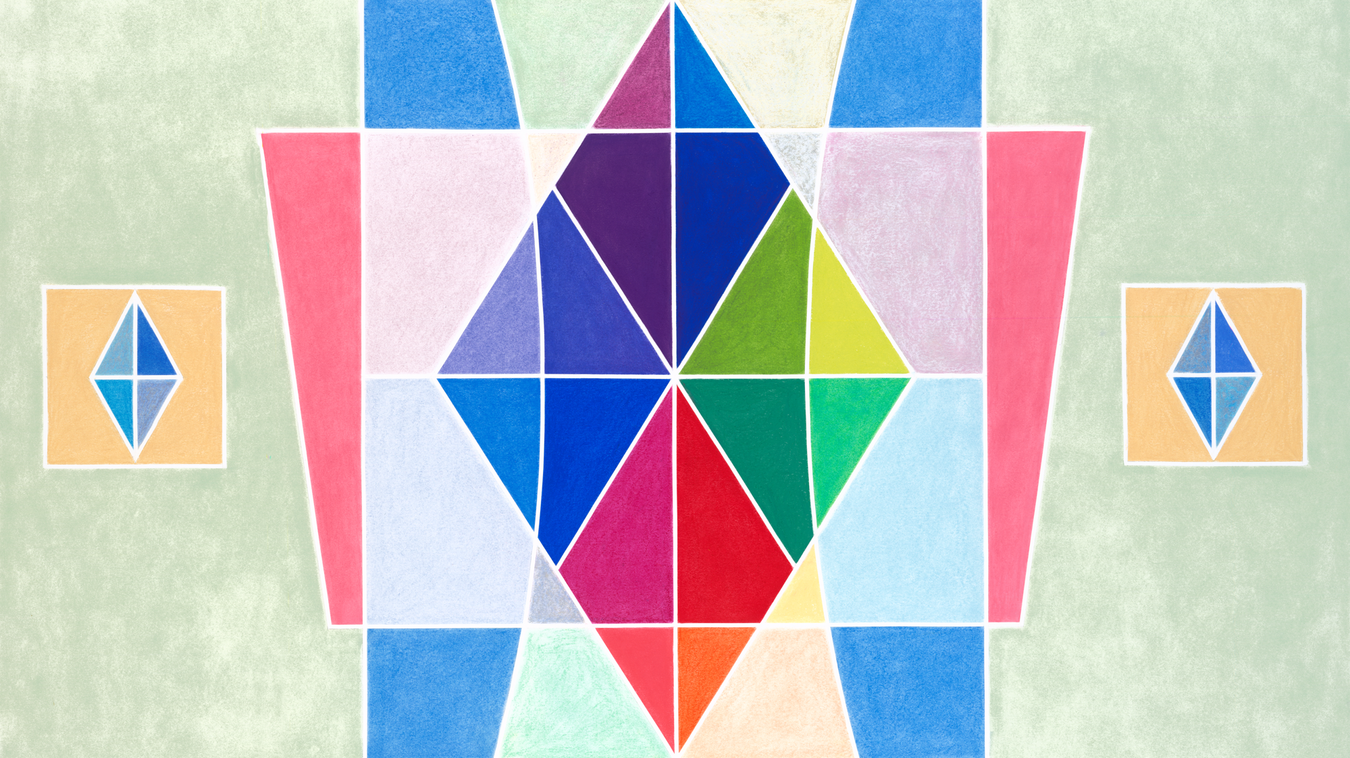



Slide 12
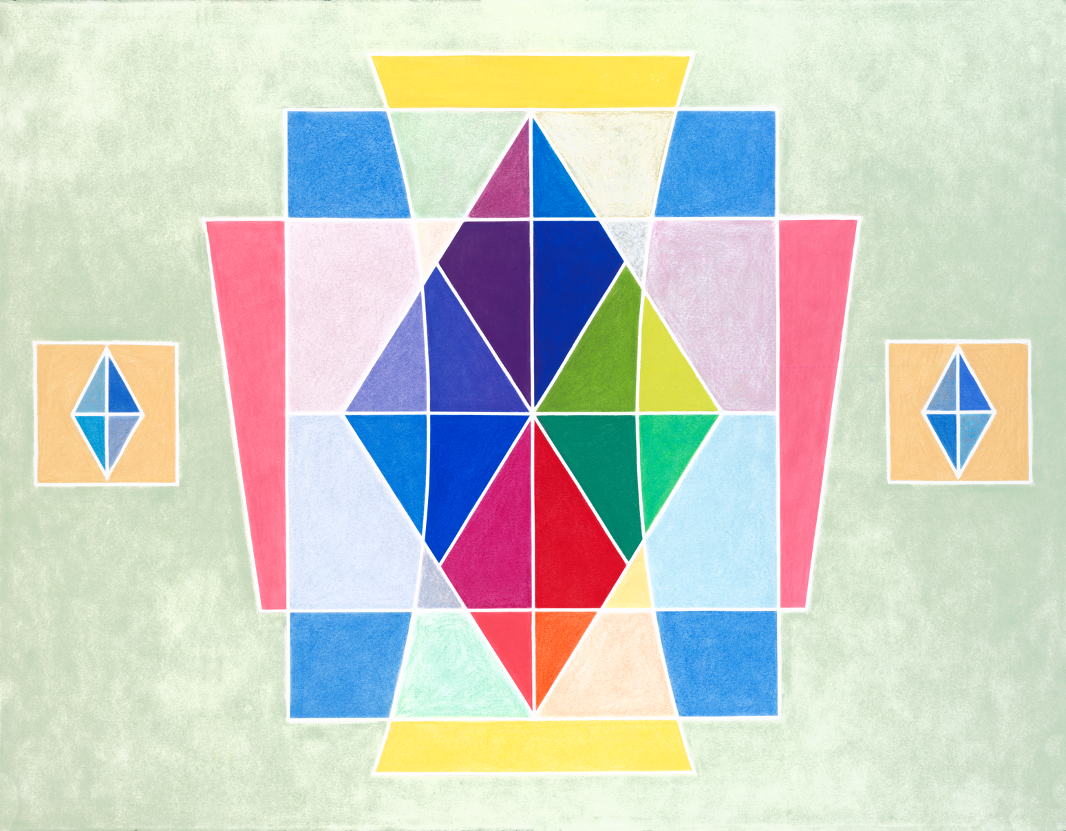
About the artist
Alicia Sterling Beach
Los Angeles-based artist Alicia Sterling Beach uses watercolors, colored pencils, and soft pastels to bring beauty into the world. Growing up with the vivid colors and music of Latin America, as well as the Native cultures of the American Southwest, her artwork is informed by her history and inspired by nature, light, and classical music. Beach’s work is featured on artlifting.com, a platform for artists impacted by housing insecurity and disabilities. In this piece, she combines symmetry and joyful colors to express balance, harmony, and spiritual attainment.

